Slide 1
Machine Learning
Abel Sanchez, John Williams

Slide 2
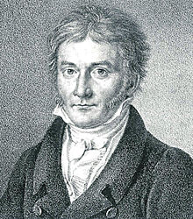
Carl Gauss
Note that this method was discovered by Carl Friedrich Gauss in 1795 (as noted by Gauss in his publication of the method in 1809). He was 17 years old at the time. The method was, however, first published by Adrien-Marie Legendre in 1805, and the most famous priority controversy in statistics followed Gauss's 1809 publication and comments about his developing it in 1795. It is a sad truth about priorities, but Gauss would have been recognized as the founder of many discoveries if only he had not been so slow in getting his ideas published (such as on complex analysis but Cauchy published it first, or on theory of elliptical functions but Abel and Jacobi published it first, and or on non-Euclidean geometry but Lobachevsky and Bolyai published it first). On the other hand, it is also known that Gauss was openly involved in the detailed development of the theory of least squares for many years. For more information on the history of linear regressions, review the translation of Gauss's memoirs by Stewart (1995) and the translator's excellent discussion and comments therein. See also Stigler (1981).

Slide 3
Machine Learning (Practical Definition)
Start with data
Learn a model from data, identify a pattern in data
Use pattern to gain insight

Slide 4
Examples
Prediction – e.g. Is this transaction fraudulent?
Prediction – e.g. Will user click on link?
Exploration – e.g. Processing larger numbers of documents
Exploration – e.g. Visualization patterns

Slide 5
Your Life is Impacted by ML
What adds you are shown
What news articles you are offered
Other shoppers like you bought …
E-dating
Security screening
...

Slide 6
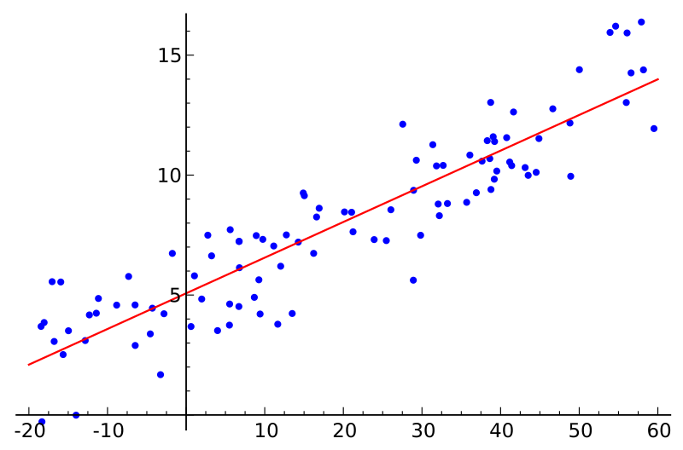
Linear Regression

Slide 7
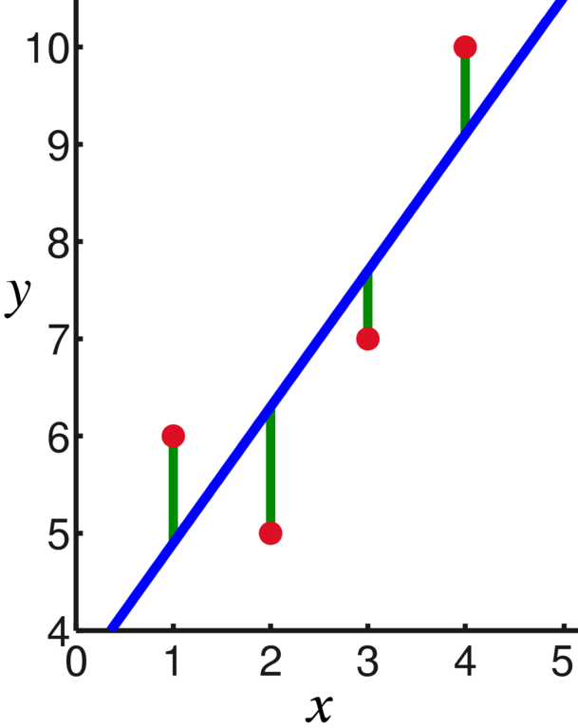
Least Squares
d4
D = (d1)² + (d2)² + (d3)² + (d4)²
Best linear model will have
the smallest sum of distances squared (D)
d3
d2
d1

Slide 8
Linear Regression
Error = D = (d1)² + (d2)² + (d3)² + (d4)²
But for a min or max partial derivatives of D must = 0
Remember we are trying to find how m and b affect the error.
In class derive the equations for m and b

Slide 9
Linear Regression
Slope
Intercept
Regression
Equation
Line

Slide 10
Active Learning
Write a function to create the linear regression equation …

Slide 11
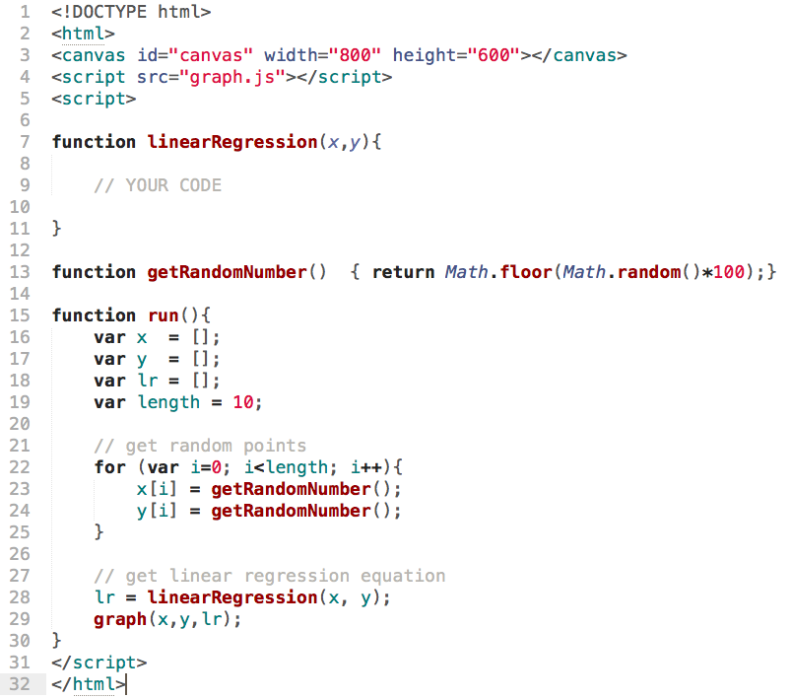

Slide 12
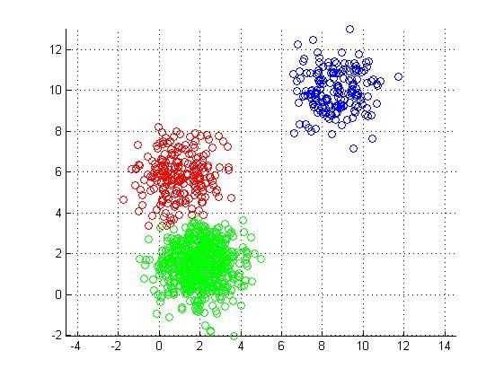
K-Means

Slide 13
Algorithm
Place K points into the space represented by the objects. These points represent initial group centroids.
Assign each object to the group that has the closest centroid.
When all objects have been assigned, recalculate the positions of the K centroids.
Repeat Steps 2 and 3 until the centroids no longer move.

Slide 14
K-Means Algorithm
start
add k points
(initial centroids)
Assign each point to closest centroid
yes
no
Centroid movement
end
Group based
on assigned centroid
Recalculate k centroids

Slide 15
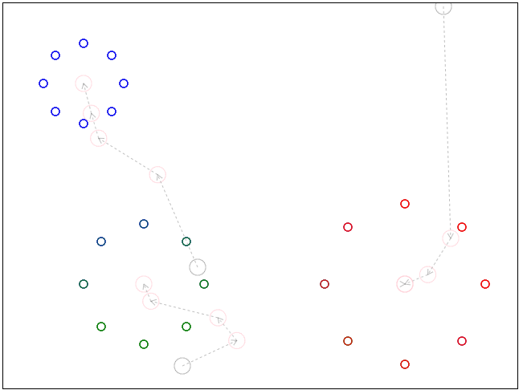
Visualization

Slide 16
Start
progress values 0 – to – 1
x₁, y₁
x_{i} = x₁ + (x₂ – x₁)•progress
y_{i} = y₁ + (y₂ – y₁)•progress
x_{i}, y_{i}
y₂ – y₁
x₂, y₂
End
progress
x₂ – x₁

Slide 17
You have x₁, y₁ and x₂, y₂ - Find y_{i} given x_{i}
Slope, m = (y₂ – y₁)/(x₂ – x₁)
Substitute x_{i}, y_{i} for x₂, y₂
The equation is:
y = y₁ + m(x – x₁)
Start
x₁, y₁
y₂ – y₁
y_{i}
x₂, y₂
x_{i}
End
progress
x₂ – x₁

Slide 18
Active Learning
Write an implementation of K-Means …

Slide 19
